Slide 1

A Parallel Algorithm for MISTs in Bubble-Sort Networks
Presented by:
M. Huzaifa (22i-1220)
M. Sarmad (22i-0941)
M. Umar Hassan (22i-0942)
Notes:
1

Slide 2
Selected Paper:
Title: A parallel algorithm for constructing multiple independent spanning trees in bubble-sort networks
Drive Link: https://drive.google.com/file/d/1leYyetxK3SqK8abssBw3QsNsD-T_Xwn_/view?usp=sharing

Slide 3
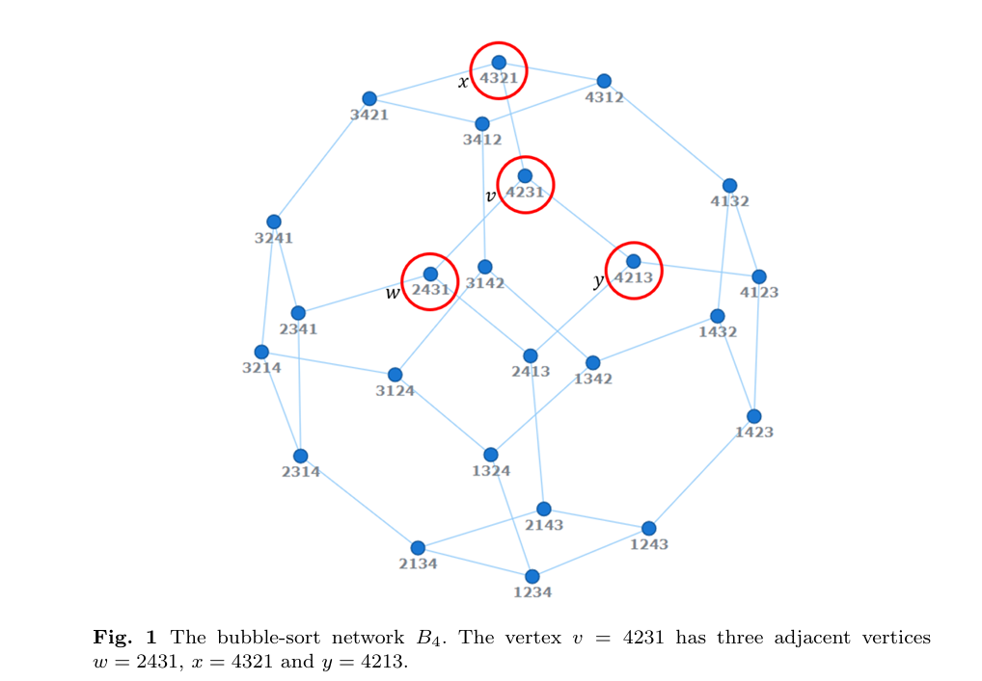
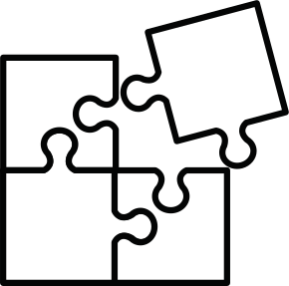


Problem Statement
Challenge
Design fault-tolerant, secure networks with disjoint paths.
Solution
Requires Multi-path routing and Multiple Independent Spanning Trees (MISTs).
Limitations
Existing recursive MIST algorithms in Bₙ lack parallelization.
Notes:
2

Slide 4

Paper Goal
Develop a parallelizable algorithm for constructing Multiple Independent Spanning Trees (MISTs).
Proposed solution specifically designed for Bubble Sort Networks.
Notes:
2

Slide 5
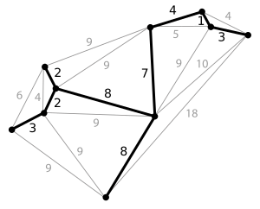
Terminology: Spanning Trees
Definition
Properties
A spanning tree connects all nodes with no cycles.
Includes all vertices of graph
No cycles, minimal edges
Uses
Routing backbones, broadcast trees, minimize communication cost.
Notes:
3

Slide 6
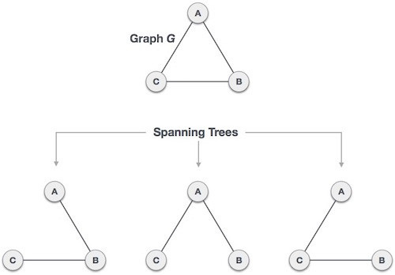
Terminology: Spanning Trees
Notes:
3

Slide 7
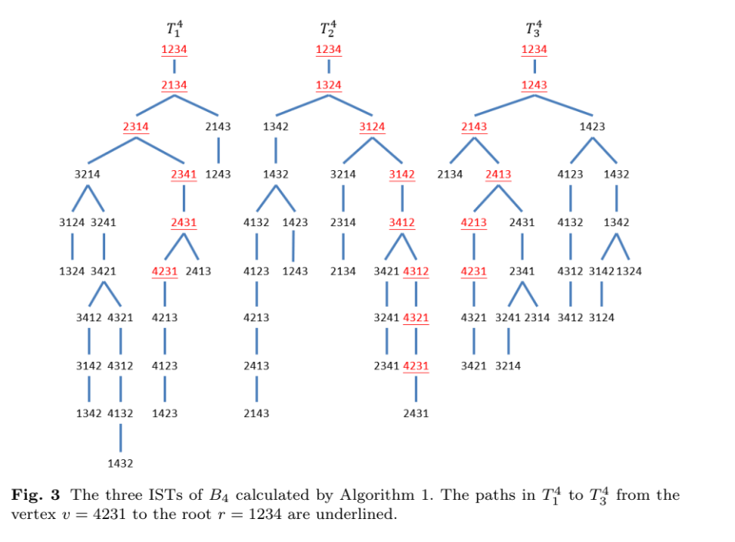
Terminology: Multiple Independent Spanning Trees (MISTs)
Definition
set of independent spanning trees constructed from the same connected graph G.
Properties
Valid spanning trees of graph
Edge-disjoint or vertex-disjoint paths
Up to k trees in a k-connected graph
Notes:
3

Slide 8
Terminology: Multiple Independent Spanning Trees (MISTs)
Uses
Fault Tolerance: If a node or edge fails in one tree, others can still function — crucial in network reliability.
Parallel Routing: Allows load balancing and reduced congestion by routing data over multiple trees simultaneously.
Security & Resilience: Splitting messages across trees improves confidentiality and resistance to data loss.
Notes:
3

Slide 9
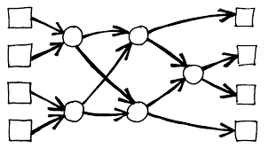
Terminology: Bubble-Sort Network (Bₙ)
Definition
Properties
A graph where nodes are all permutations of n elements, and edges represent adjacent swaps (like bubble sort).
Vertices: All n! permutations
Edges: Adjacent transpositions
Structure: Cayley graph
Connectivity: n−1
Diameter: n(n−1)/2
Uses
Test routing algorithms
Simulate broadcasting
Study network resilience
Notes:
5

Slide 10
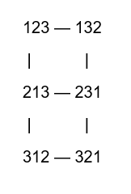
Terminology: Bubble-Sort Network (Bₙ)
Example: Bubble sort graph of dimension 3
Permutations:
{123,132,213,231,312,321}
Edges:
Each node is connected to others by swapping adjacent elements
Each edge is an adjacent transposition (like how bubble sort makes swaps).

Slide 11
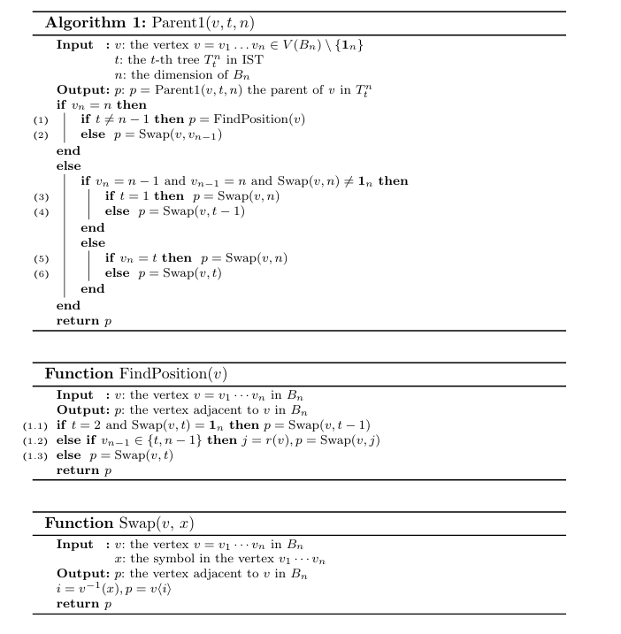
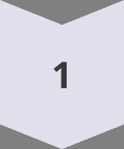
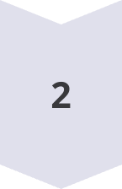
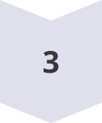
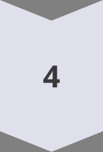
Algorithm Overview
Core Function
Parent(v, t, n) computes parent of vertex v in tree Tₙᵗ.
Preprocessing
Compute v⁻¹ (inverse permutation)
Find r(v): first misplaced symbol position
Decision Rules
Swap based on conditions of t, rightmost incorrect symbol, or default position v t.
Parallelism
Each vertex’s parent computed independently, suitable for parallelization.
Notes:
6

Slide 12
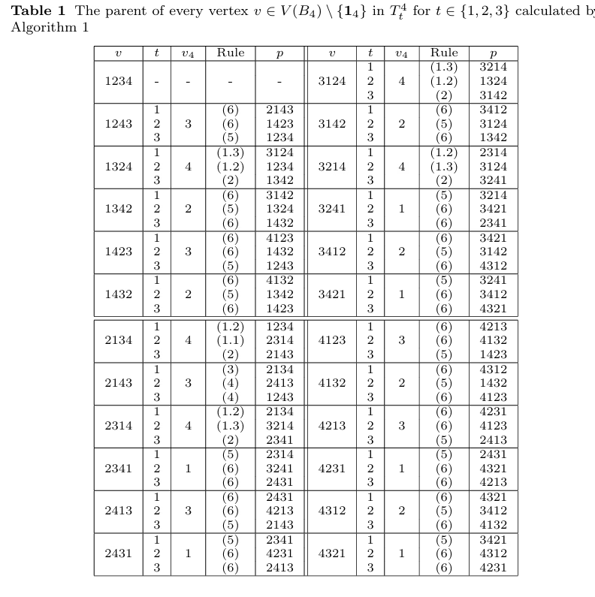
Results and Complexity
Time Complexity Analysis:
Per Vertex: O(n) time to compute parent
Total: O(n × n!) for all vertices in Bₙ
Parallelism:
Fully parallelizable — each vertex’s parent computed independently
Upper Bound:
Asymptotically optimal for Bubble Sort Network of size n!
Notes:
7

Slide 13
Proposed Solution
No Need for METIS
Parent computation is fully local, so graph partitioning is unnecessary.
Embarrassingly Parallel Problem (No communication needed between machines)
MPICH – Inter-node Parallelism
Distributes Spanning Tree Construction across machines
Master assigns tree ranges to each machine
Workers return constructed subtrees to master
Notes:
8

Slide 14

Proposed Solution
OpenMP – Intra-node Parallelism
Used within each machine for vertex-level parallelism
Parent computation parallelized using OpenMP threads
No synchronization needed due to independence of iterations
Notes:
8

Slide 15


